Slide 1

Communication and Culture— English Viewing, Listening & Speaking
交际与文化视听说
2025年2月

Slide 2

Course
Orientation
Target students: Non-English major, sophomore
Credit: 2

Slide 3
Communication and Culture
English Viewing, Listening & Speaking
Q1
This course is going to be about___________ ?

Slide 4
English Viewing, Listening & Speaking
Communication and Culture
To communicate
by way of
viewing
listening
speaking
About Culture

Slide 5
Culture
diversify: v. 多样化
Definitions of culture DIVERSIFY.
Different definitions highlight different aspects
Some even conflict with each other
Let’s give it a shot:
My understanding about culture

Slide 6


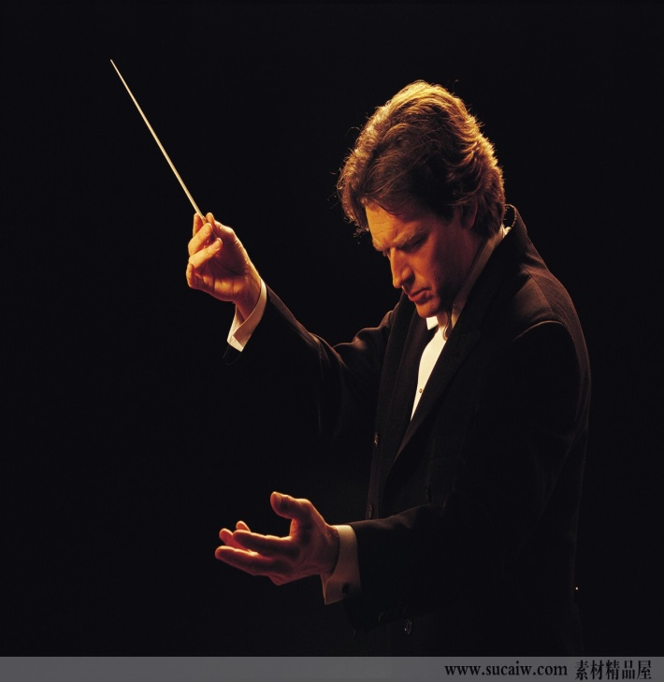
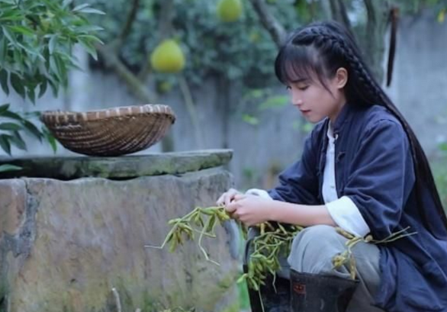
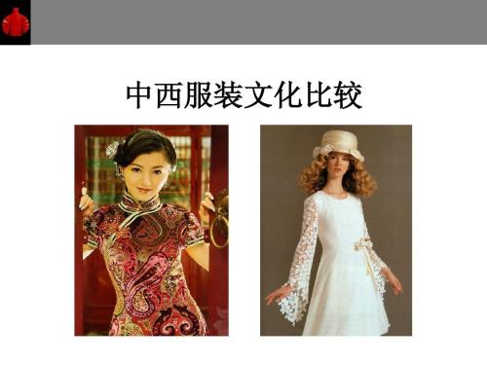
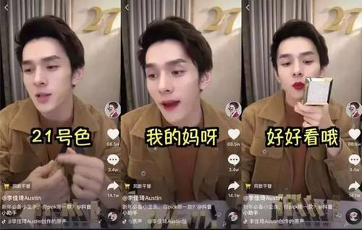

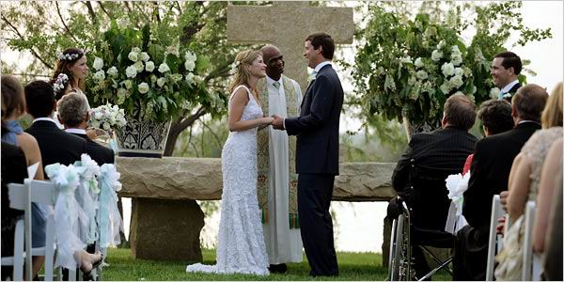
carrier & embodiment of culture (文化的载体与外显)
The way of doing things and its outcome: observable & tangible

Slide 7
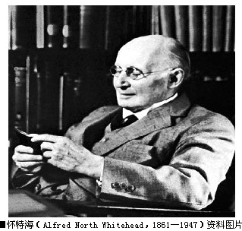
Culture
Definition:
（1）a way of doing things (behaviors/customs/ products/ phenomena)
（2）a way of thinking
(values and beliefs regarding the world, human beings and concerning what is right, what is important, or what is the most desirable )

Slide 8

Case Study 1
carp：n 鲤鱼
lotus：n 莲花
subtle： a.含蓄的
New year wish:
traditional Chinese way
lotus + carp
homophony (同音异义）
年年有余
having surplus in the new year
a word game
an indirect/subtle way

Slide 9

New year wish:
American way
clearly written on the card
in a direct way and in clear language

Slide 10



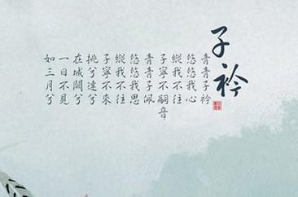


word game
clear writing
Chinese ways for feeling expression and art creation :
Indirect/implied/, euphemism
Western ways for feeling expression and art creation:
direct /explicit , rich /strong
Thoughts/values about world and human differ

Slide 11

Culture
The way of doing things
The way of thinking
( by education and socialization)

Slide 12
Culture
Behaviors/customs/ phenomena (行为层面)
carrier & embodiment of culture (文化的载体与外显)
The value /belief system (观念层面)
core & foundation of culture (文化的内核与根基)

Slide 13

How to communicate about culture in this course
I see and Identify
What are these cultural behaviors/phenomena
Compare and contrast
How are these cultural behaviors/phenomena different across cultures?
Explore and Explain
Why are there such differences?

Slide 14
Case study 2
My American landlady was over 70, and we got along very well.
One day, when we were ascending the stairs together, I stretched out my hands to give her some help.
At the sight of my gesture, she said: “ I can do it, thank you.”
I thought she was just being polite, so I escorted her to the top of the stairs.
On the way up, she did not utter a word, her facial expression hinting that she did not appreciate my kindness.
escort: v. 陪同：v

Slide 15
Case study
After pausing a minute or two, she continued her way up alone.
Not being aware of my improper “over-kindness”, I practiced “Leifeng” once again.
This time, half-jokingly and half seriously, my landlady turned to me and said : “Young man, do you think I am old and useless? When I have to move myself on a wheelchair, I’ll ask you for help.”

Slide 16
Case study: Analysis
Identify the behaviors
Q3：What has this Chinese student done to his American landlady ?
Q4: What was the response of this American lady?
Compare and contrast the behaviors across culture
Q5： How do we Chinese people evaluate the behavior of this
Chinese student ?
Q6：Gathering from the American lady’s response, how do they
evaluate this behavior?

Slide 17
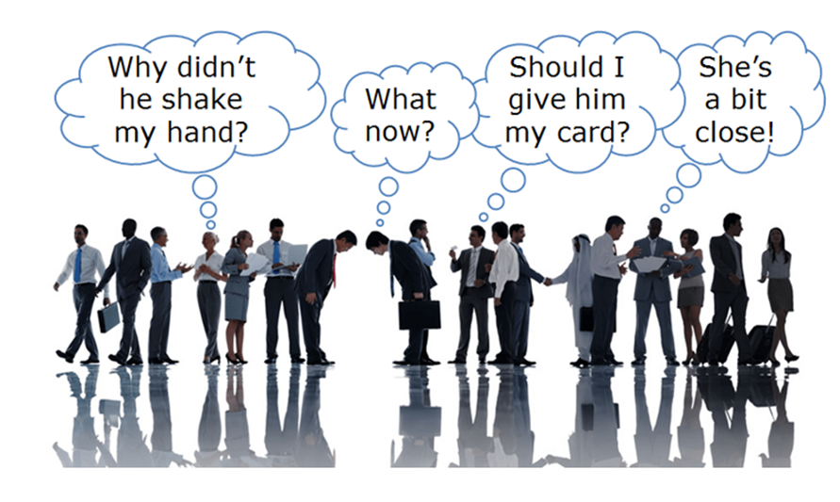
Case study: Analysis
Provide explanations to the different behaviors as they are
Q7： Can you give any reason explaining these different responses
to this Chinese student behavior?

Slide 18
Case study：Reasons behind -Value/ belief
according to Chinese cultural values :
Being old in Chinese culture symbolizes________
Mentally experienced and wiser
Physically weak
deserves respect and extra care
Enjoy being treated with extra care and respect
Chinese students’ offer of help = expressing his care and respect
a proper behavior worthy of praise and advocation

Slide 19
Case study：Reasons behind -Value/ belief
according to American cultural values
Being old in American culture symbolizes________
Mentally especially physically weak and feeble
Lack of masculinary (阳刚的，充满男子气概的) power
being useless
are not willing to be regarded
Reluctant to admit
Chinese students’ offer of help =taking the lady as “being old”, and “being useless”
Be offending
Be refused and declined

Slide 20

Case study: A full understanding of culture
Behaviors:
Chinese student: offering help
American landlady: declining the help
Value/ belief:
Different evaluations of “being old”.

Slide 21

Theory-learning (case-based generalization)
The problem of both people: They tend to ?
Cultural barrier leading to the failure of cross-cultural communication：
Assuming similarities instead of differences
The tendency of interpreting and judging the other cultural behaviors/ phenomena from the norms of one’s own culture
( Refer to Micro-lecture Unit 4 )

Slide 22
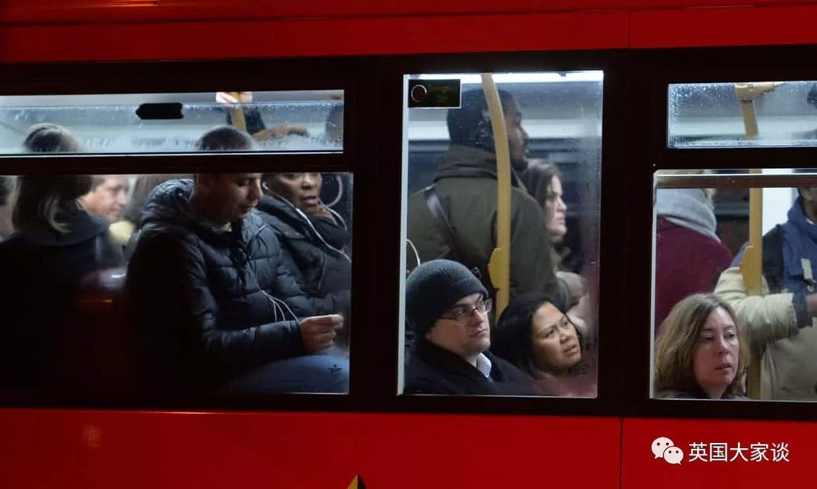

Aims of this course (1) : Cultural competence
Strengthen sensitivity to cultural behaviors/ phenomena
(avoid being ignorant and shallow)
Cultivate cultural awareness in cross-cultural communication
(avoid being misinterpreting and prejudiced)

Slide 23
Communication ability
Aim of this course (2)
Substance （借着文化的丰富性， 拓宽交流的广度）
Inclusiveness (借着文化的异质性， 培养交流的包容度)
Depth (借着原因的探索与挖掘， 增加交流的深度）

Slide 24
Better speaker
of English
More tactful communicator
A person of culture competence
in cross-cultural communication

Slide 25


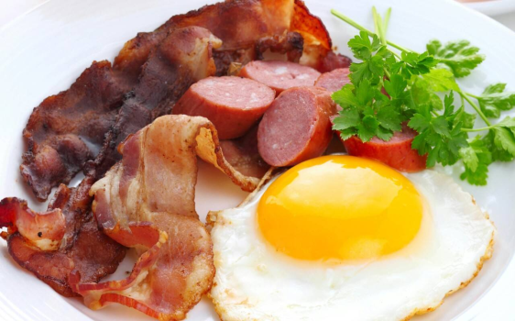

Goals reality
Learning & training
Unit 1 Learning
Unit 2 Relationships
Unit 3 Food & Drink
Unit 4 Career
by viewing, listening and speaking

Slide 26


Session 4:
文化理论升华
文化态度养成
Session 3:
文化原因深挖
Session 2:
文化差异比较
Session 1:
文化现象初探

Slide 27
Schedule
Week 16:
Listening & reading Test
Week 18:
Final Test
Week 1-15:
4 Units
Week 17:
Q & A

Slide 28

Course management
课堂
学习通（超星）自学微课
QQ群：上课参与与记录，提交录音作业，
小组：自建小组QQ群，完成小组项目。

Slide 29
Course Evaluation
形成性成绩 (60%) ：
个人 （20 分）：
课后录音（10分）+ 专项考试（10分）
小组 （40 分）
微课测试题讲解汇报+Project 1 ( PPT) + Project 2 ( Poster ) + Project 3 (Micro-video)
终结性成绩 (40%) ：水平测试，年级统一, 难度相当于六级考试

Slide 30
Reminder：关于价值观在文化中的处境与作用，不能忽略以下几个points:
核心原因 V.S. 并非唯一原因
相对稳定性 V.S. 并非固定不变
作为主流的values of cultural group V.S. values of individuals 或 values of the culture within culture
价值观的对立与碰撞 V.S 普世价值观上的一致
后天价值观的形成 V.S 先天人性的特点

Slide 31

Thank you

